Slide 1
Vision Transformers
How the Transformer architecture — the engine behind large language models — is reshaping the field of computer vision.

Slide 2
Contents
01
02
How CNNs "See": The Local Lens
The Breakthrough: Vision Transformers (ViTs)
03
04
CNN vs. ViT — Two Philosophies of Seeing
The ViT Architecture
05
06
Pre-Trained Model for ViT
Key Takeaways

Slide 3

The Challenge: Teaching Machines to See
For decades, Convolutional Neural Networks (CNNs) have been the workhorses of computer vision — identifying patterns by scanning images in a structured, hierarchical, and fundamentally local manner. But is looking closely always enough?

Slide 4
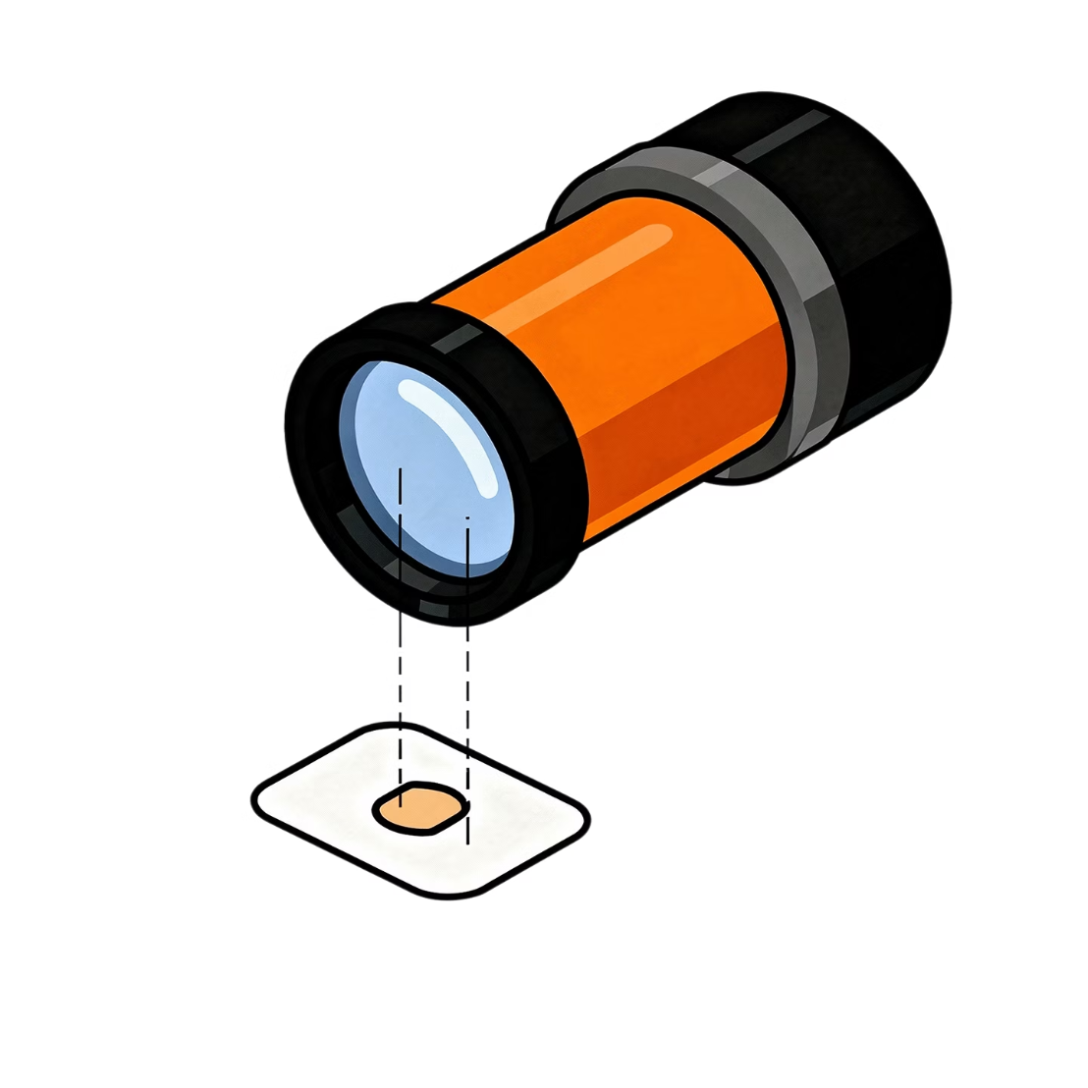

How CNNs "See": The Local Lens
01
02
Small Receptive Fields
Early Layers: Edges & Textures
Filters slide over tiny patches of the image, one region at a time.
Simple low-level features are detected first — lines, colours, gradients.
03
Deeper Layers: Shapes & Objects
Features combine progressively into complex, recognisable structures.
Like a microscope — powerful detail, one patch at a time.

Slide 5
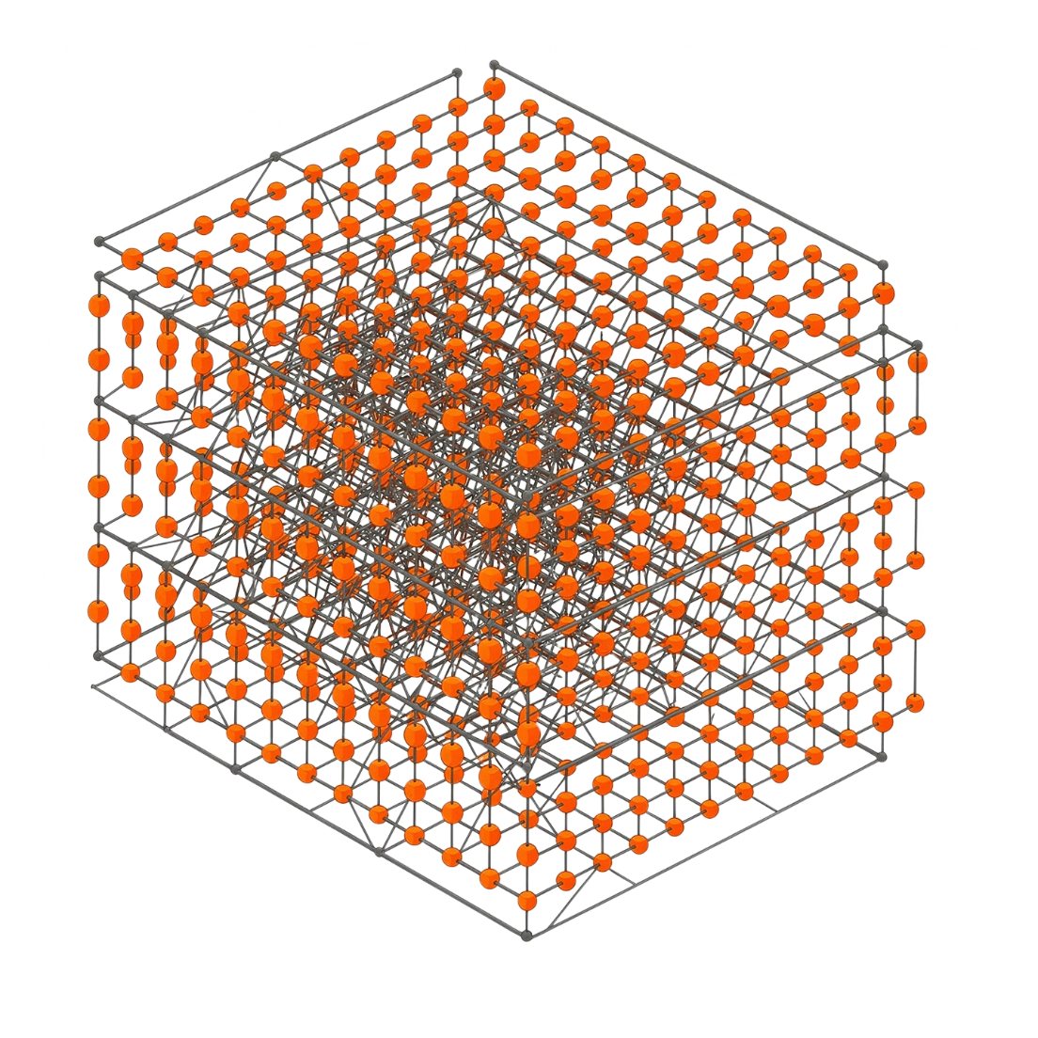
The Breakthrough: Vision Transformers (ViTs)
🧩 Patches as Tokens
🔗 Self-Attention
🌐 Global Context
An image is divided into fixed-size patches, each treated as a word in a sentence.
Every patch attends to every other patch simultaneously — not sequentially.
Long-range relationships across the entire image are captured in a single pass.

Slide 6
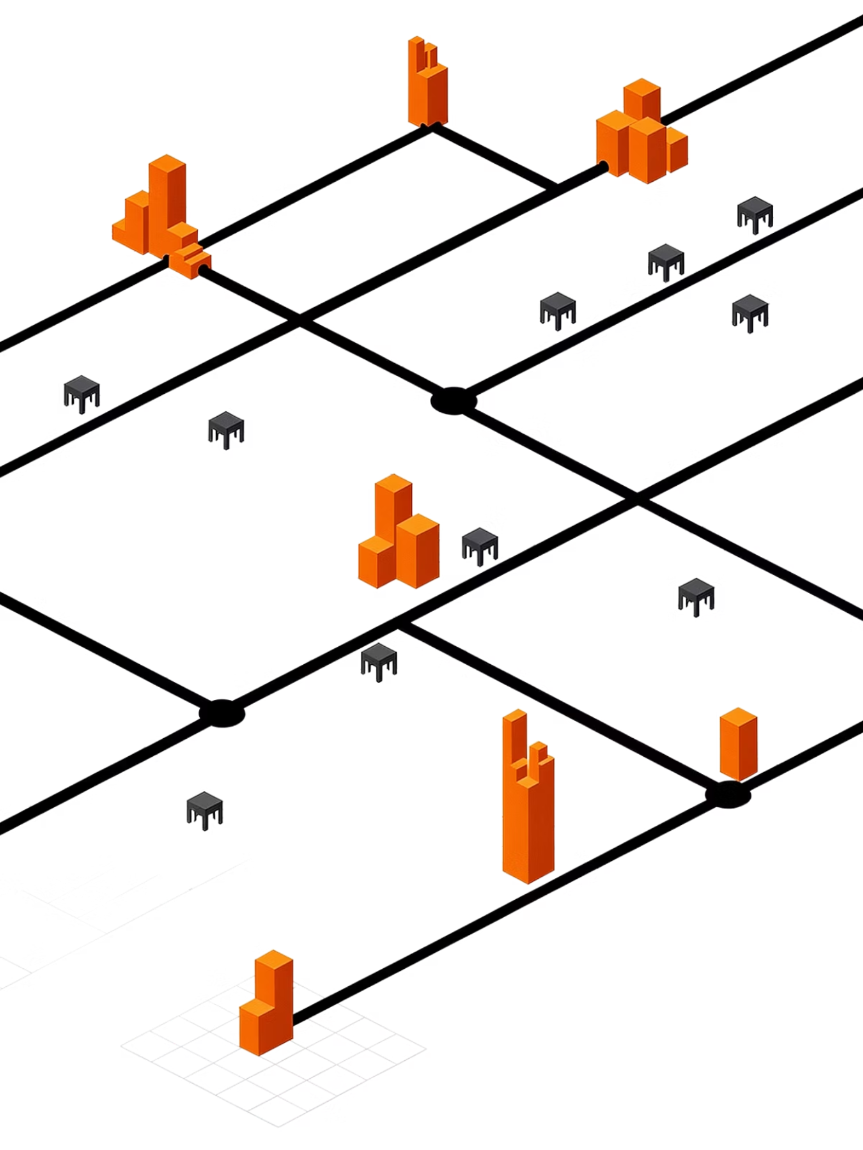
How ViTs "See": The Global Canvas
Rather than scanning patch by patch, ViTs ask: "How does every part of this image relate to every other part?" The self-attention mechanism assigns importance weights across all patches simultaneously — capturing the forest and the trees.

Slide 7

The ViT Architecture — Inside the Pipeline
Linear Projection
Positional Embeddings
Patches flattened and mapped to embeddings.
Order information added to each vector.
Patch Extraction
Transformer Encoder
Image split into 16×16 patches.
Self-attention layers with a CLS token.
The [CLS] token — prepended to the patch sequence — accumulates global information across all self-attention layers and serves as the final representation for classification.

Slide 8
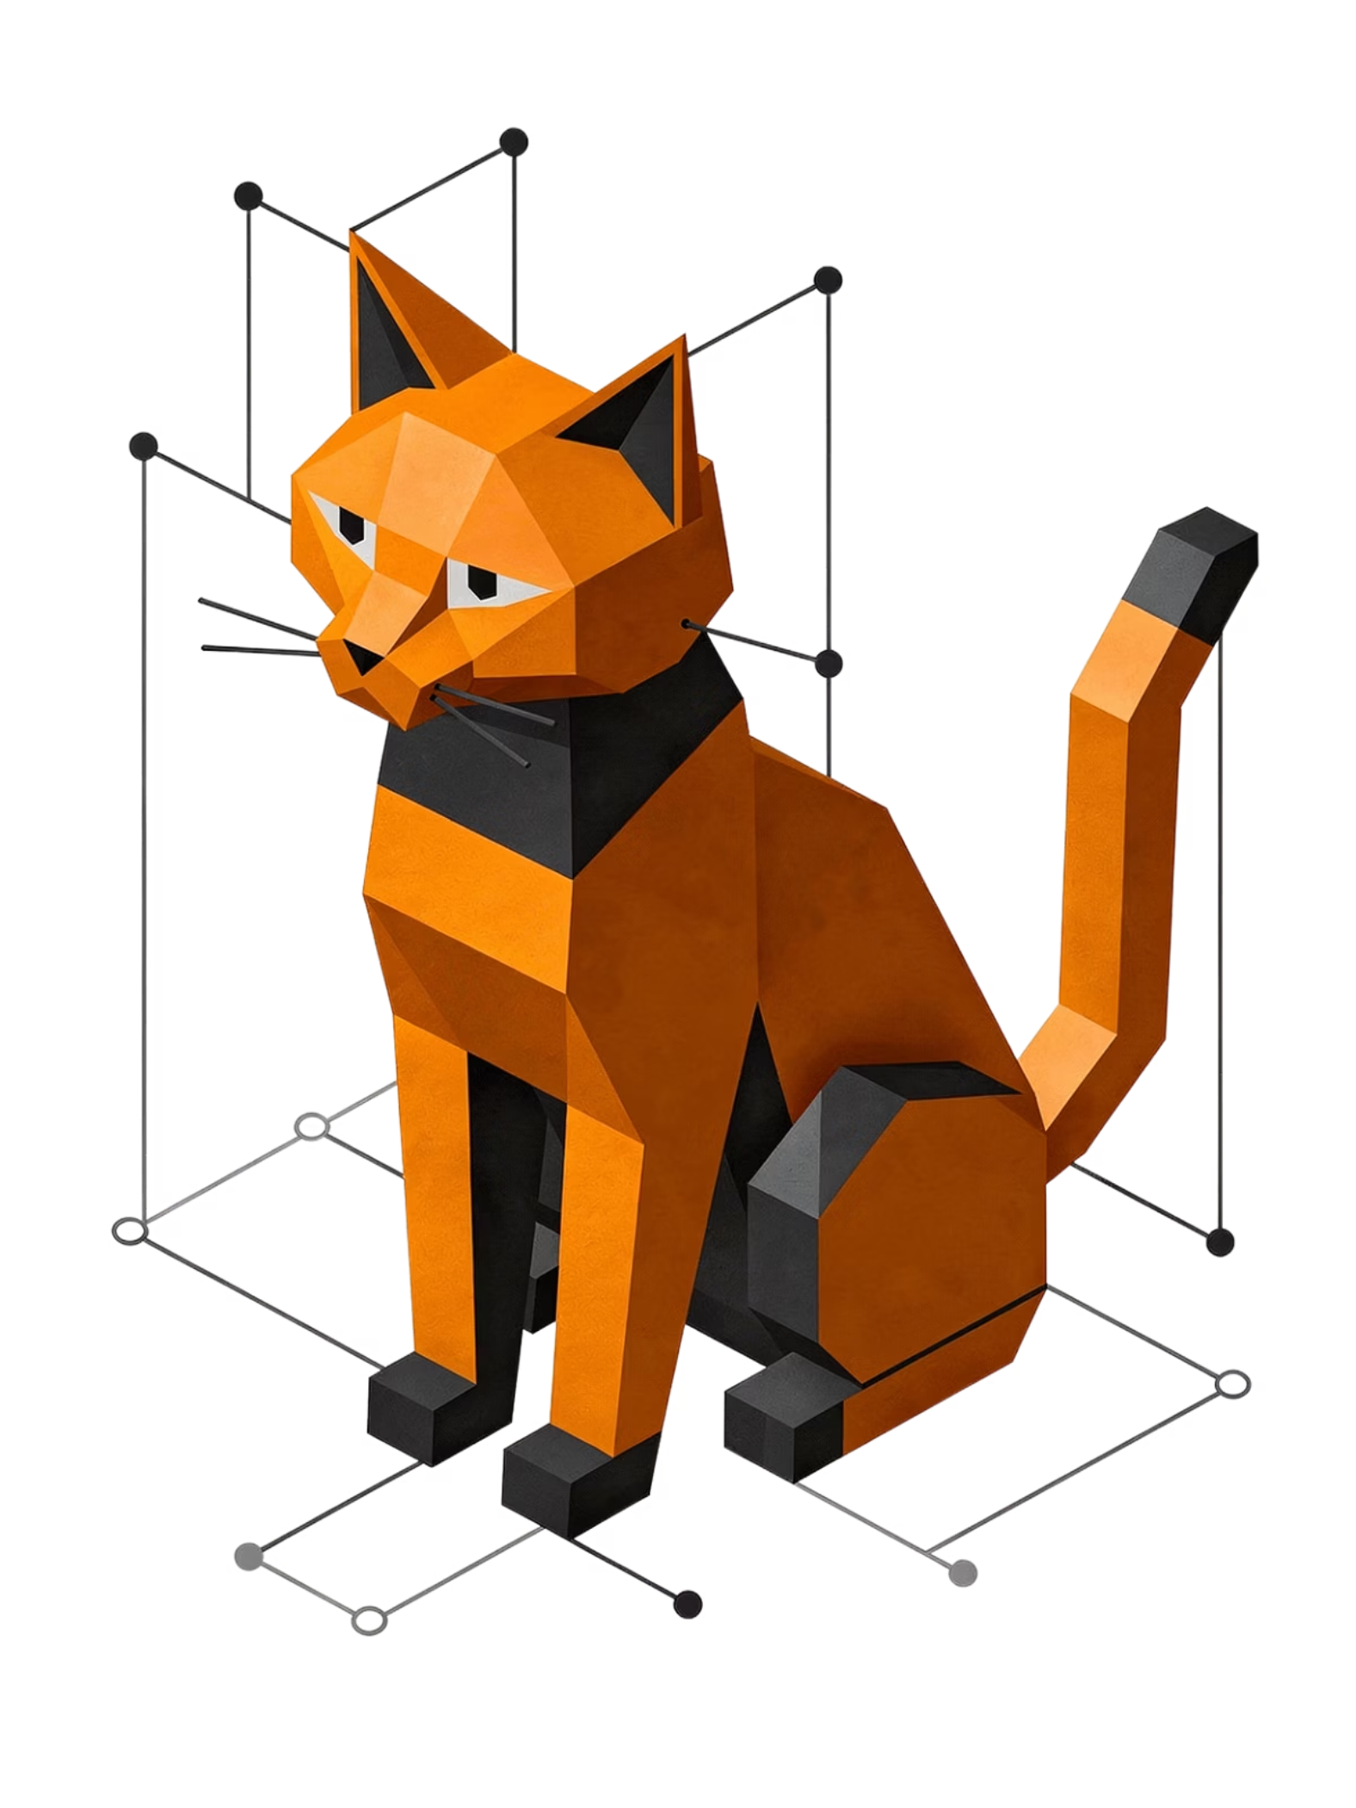
Connecting the Dots
A ViT doesn't just find the ear — it understands how the ear relates to the tail, the paw, and the background, forming a holistic understanding of the subject as a unified whole.

Slide 9
Visualising the Difference: A Cat Example
🔬 CNN Approach
🌐 ViT Approach
Detects fur texture → recognises ear shape → identifies eye shape → combines into "cat." Sequential and hierarchical — bottom-up feature building.
Simultaneously considers the ear patch, eye patch, tail patch, and background together — understanding from the outset that these patches belong to one unified entity.

Slide 10
CNN vs. ViT — Two Philosophies of Seeing
CNN: The "Local" Detective
ViT: The "Global" Storyteller
CNNs scan images using small sliding filters — identifying edges, textures, and shapes in local neighborhoods. They carry a strong inductive bias: nearby pixels are assumed to be related. Efficient on small datasets, but globally blind in early layers.
ViT processes all patches simultaneously. A patch in the top-right corner can directly "talk" to a patch in the bottom-left from layer one onward. It imposes no spatial locality assumptions — relationships are learned purely from data.

Slide 11

How a CNN Sees the Scene
A Collection of Textures
The CNN focuses sequentially on local features: the car's wheels, the person's limbs, the asphalt grain. Because the car occupies the largest region, the model often predicts "Car" or "Street Scene."
It sees the ingredients — but struggles to connect the Action (red light) to the Object (stopped car). The semantic relationship is lost across early layers.

Slide 12

How a ViT Sees the Scene
The Global "Headline"
The ViT's attention mechanism immediately highlights the bright red signal as the most categorically distinct element, mathematically down-weighting the car and pedestrian as contextual background.
Inference: "Street Light" — Confidence: 0.96
It prioritizes the most semantically unique fact over the largest visual object.

Slide 13
The Power of Pre-training
Why we rarely need to train a Vision Transformer from scratch — and what "knowledge transfer" really means
in practice.

Slide 14
What is a Pre-trained Model?
Knowledge Transfer
Efficiency via Fine-Tuning
Why ViTs Need This
Models first train on millions of images (e.g., ImageNet-21k) to internalize general visual features — edges, shapes, semantics — before ever seeing your data.
Practitioners fine-tune pre-trained weights on small domain-specific datasets, saving thousands of GPU-hours while achieving state-of-the-art results.
Unlike CNNs, ViTs carry no spatial inductive bias. They are data-hungry by design — pre-training on large corpora is not optional; it's the mechanism that closes the gap.

Slide 15
Leading Google ViT Models
Model Name
Scale / Parameters
Primary Use Case
ViT-B/16
86 Million
The "Gold Standard" baseline for general research and benchmarking
ViT-L/16
307 Million
High-accuracy image classification for enterprise-grade tasks
SigLIP
400 Million+
Multimodal tasks — connecting images to natural language descriptions
ViT-22B
22 Billion
State-of-the-art scaling with near "human-like" shape perception
Parameter count scales directly with representational capacity — choose based on your compute budget and accuracy threshold.

Slide 16

The Future of Vision: Beyond Local Views
ViTs are increasingly outperforming CNNs on major benchmarks — especially when large datasets are available. CNNs remain valuable for constrained environments, but ViTs signal a fundamental paradigm shift: from examining fragments to understanding the whole.
CNNs
ViTs
Efficient, proven, excellent on smaller datasets and edge devices.
Scalable, context-aware, increasingly dominant on large-scale tasks.
Hybrid Models
Emerging architectures combine both — local precision and global context.

Slide 17
Key Takeaways
1
Global Attention Over Local Scanning
2
Stories, Not Just Textures
3
Pre-trained Models are Your Shortcut
ViT understands the narrative of a scene — relationships between objects, actions, and signals — rather than cataloging pixels and local gradients in isolation.
ViT replaces convolutional filters with self-attention — enabling every patch to relate to every other patch from the very first layer, capturing richer semantic context.
Google's open ViT checkpoints provide a scalable, production-ready foundation. Fine-tune for your domain — don't train from scratch unless you have to.

